Slide 1
Ford Fulkerson method for Maximum Flow problem

Slide 2
problem
Given a graph which represent flow network in which every edge has a capacity
Given two vertices,Source s,and sink t in graph
Find out the maximum possible flow from s to t with following constraints
Flow on an edge doesn’t exceed given capacity of the edge
In flow must be equal to out flow for every vertex except source & sink

Slide 3
Ford-Fulkerson method for solving the maximum-flow problem.
We call it a “method” rather than an “algorithm” because it encompasses several implementations with differing running times.

Slide 4
Terminologies Used
Augmenting Path
It is the path available in a flow network.
Residual Graph
It represents the flow network that has additional possible flow.
Residual Capacity
It is the capacity of the edge after subtracting the flow from the maximum capacity.

Slide 5
Terminologies
Residual graph(residual network)
Residual Graph of a flow network is a graph which indicates additional possible flow.
If there is a path from source to sink in residual graph, then it is possible to add flow.
Residual capacity
Every edge of a residual graph has a value called residual capacity which is equal to original capacity of the edge minus current flow.
Residual capacity is basically the current capacity of the edge.original capacity of the edge minus flow denoted by Cf
if c(u,v)=16 and f(u,v)=11, then residual capacity Cf(u,v)=16-11=5
Minimal cut( Bottleneck capacity)
Decides maximum possible flow from s to t through augmented path

Slide 6
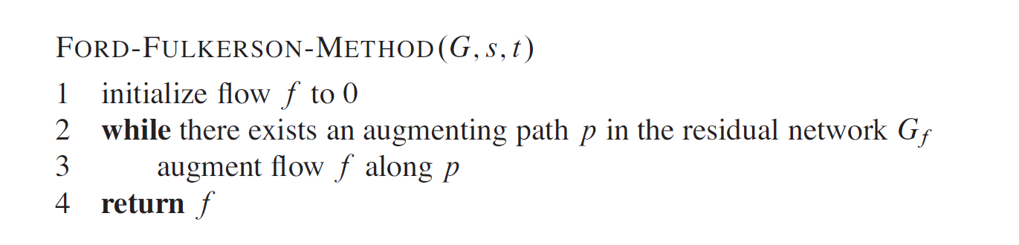
The Ford-Fulkerson method iteratively increases the value of the flow.
We start with f (u,v)= 0 for all u,v Ꞓ V , giving an initial flow of value 0.
At each iteration, we increase the flow value in G by finding an “augmenting path” in an associated “residual network” Gf .

Slide 7
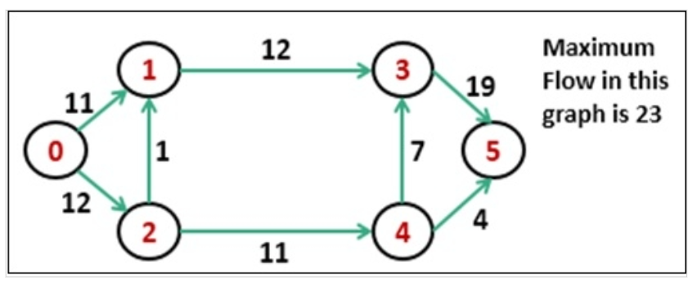
Example 1

Slide 8
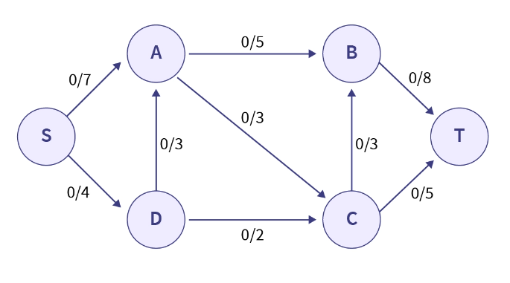
Example 2

Slide 9
Example 3
4
A
B
10
10
8
6
T
S
2
10
10
C
D
9

Slide 10
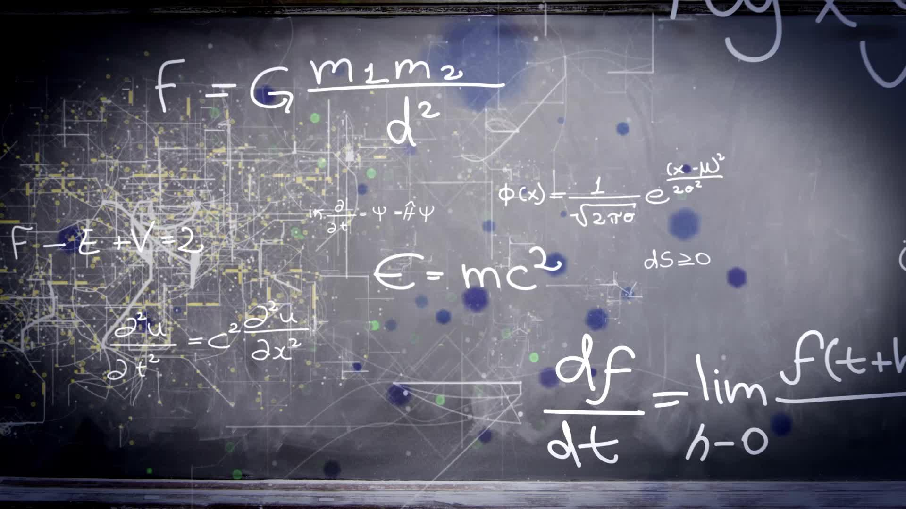
Max- Flow Min Cut Theorem

Slide 11
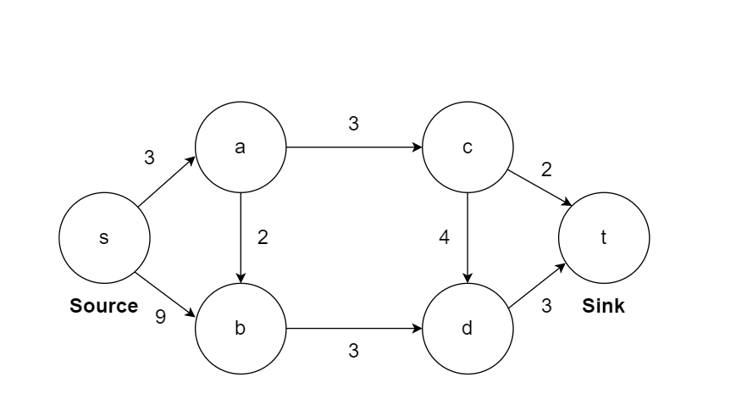

Slide 12
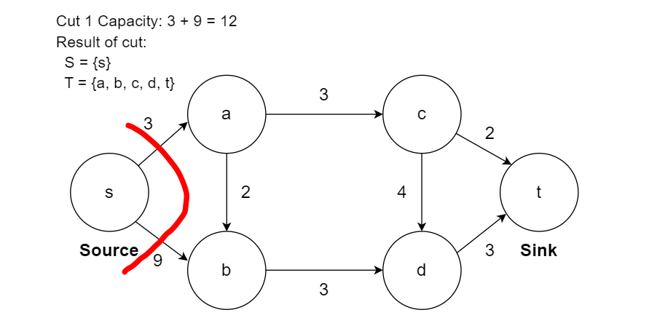

Slide 13
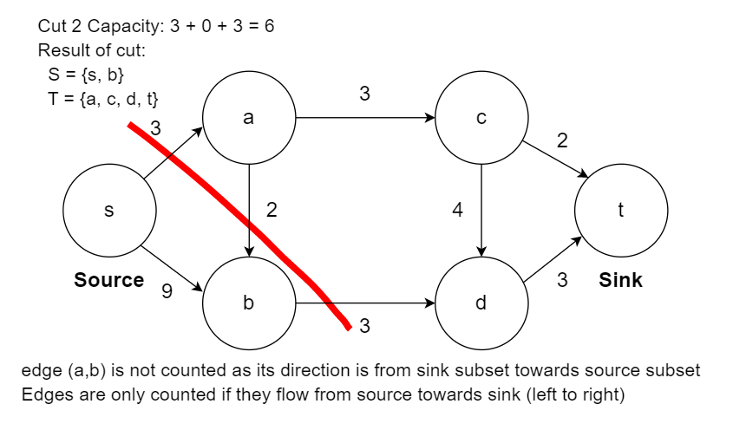

Slide 14
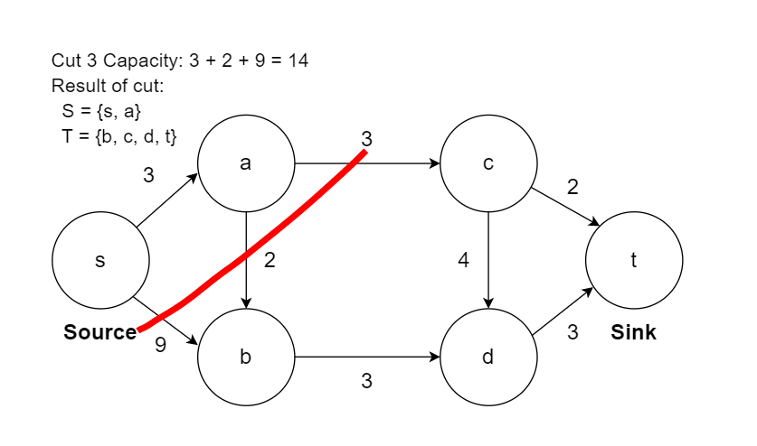

Slide 15
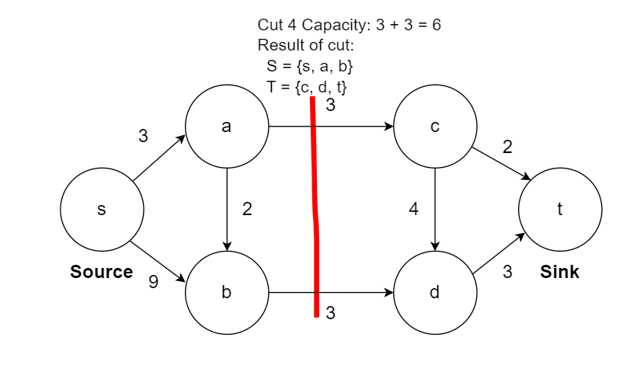

Slide 16
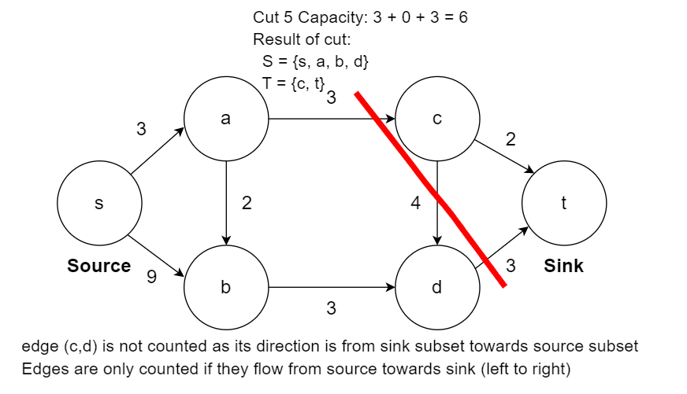

Slide 17
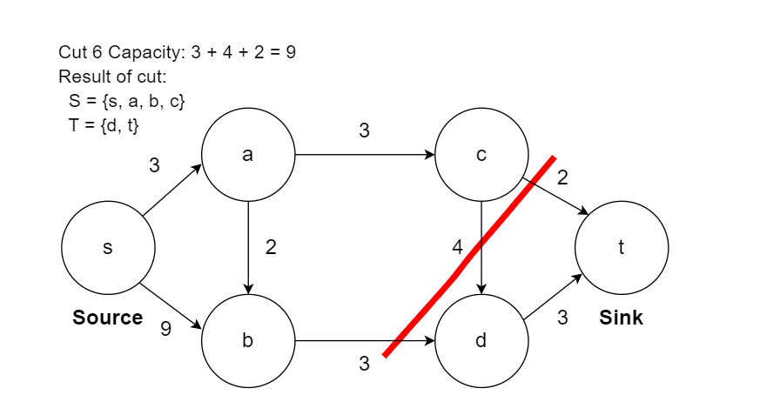

Slide 18


Slide 19
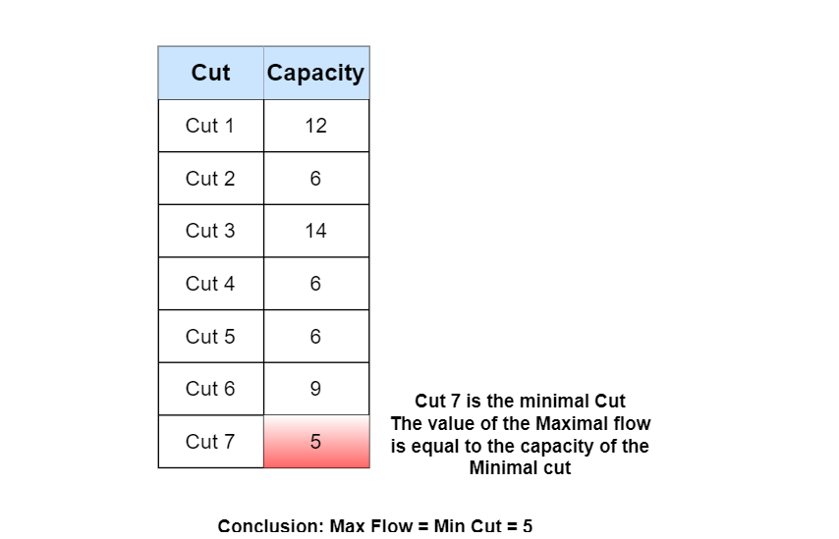
Max-Flow Min-Cut Theorem
The max-flow min-cut theorem states that in a flow network, the amount of maximum flow is equal to capacity of the minimum cut

Slide 20
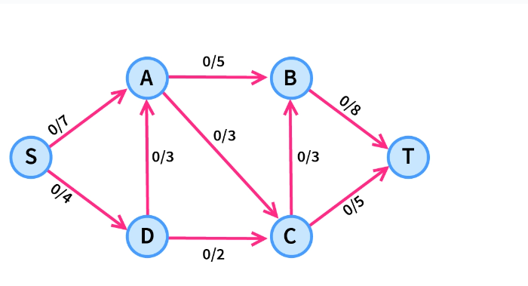
Minimum Cut in a Graph
Minimum s-t Cut Problem. Minimize c(S, T), that is, determine S and T such that the capacity of the s-t cut is minimal.

Slide 21

Bipartite matching

Slide 22
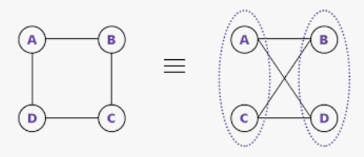
Bipartite Graph
A Bipartite Graph G = (V, E) is a graph in which the vertex set V can be divided into two disjoint subsets X and Y such that every edge e ∈ E has one end point in X and the other end point in Y .
A matching M is a subset of edges such that each node in V appears in at most one edge in M.

Slide 23
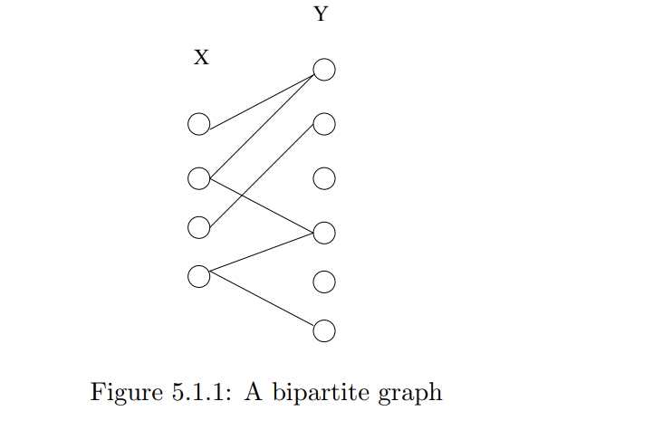

Slide 24
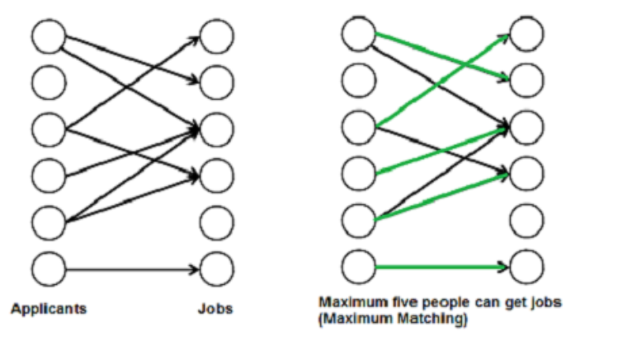
A matching in a Bipartite Graph is a set of the edges chosen in such a way that no two edges share an endpoint

